Slide 1

JMRC INTERNATIONAL

Slide 2
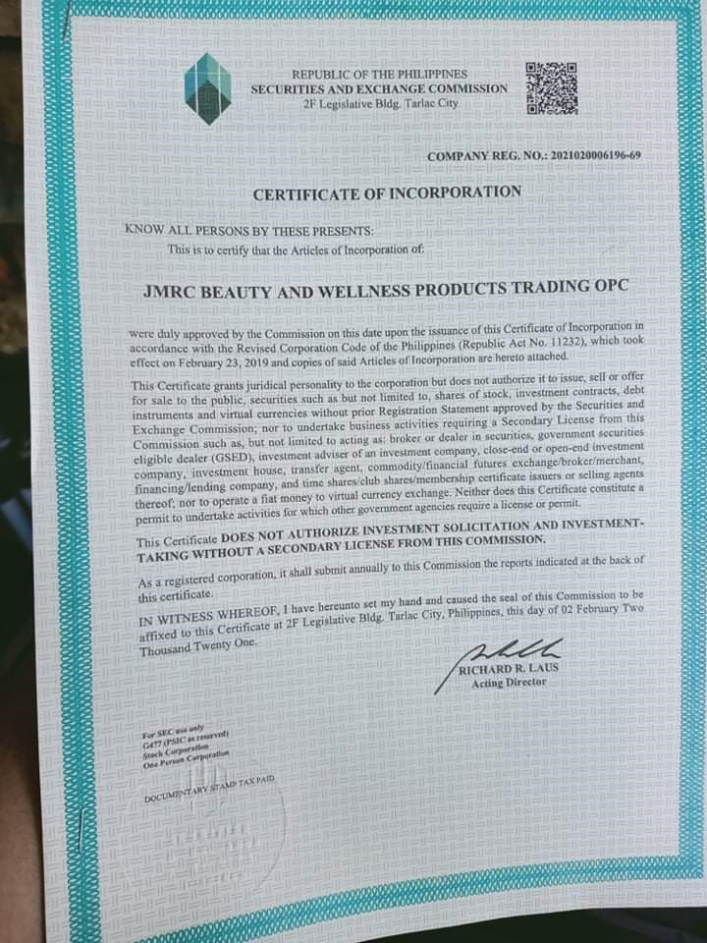
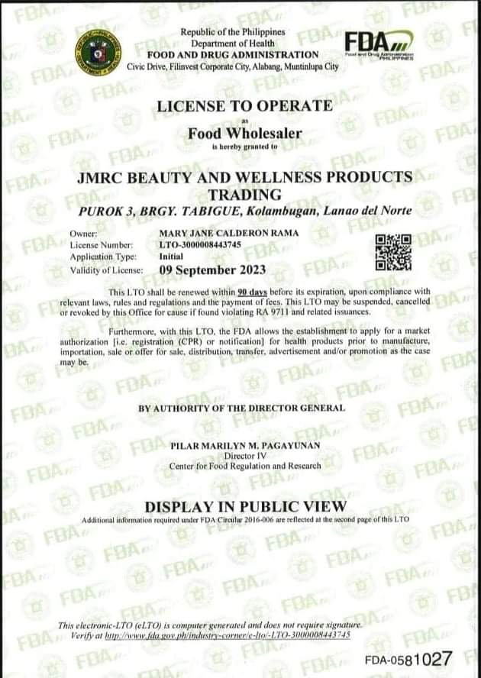
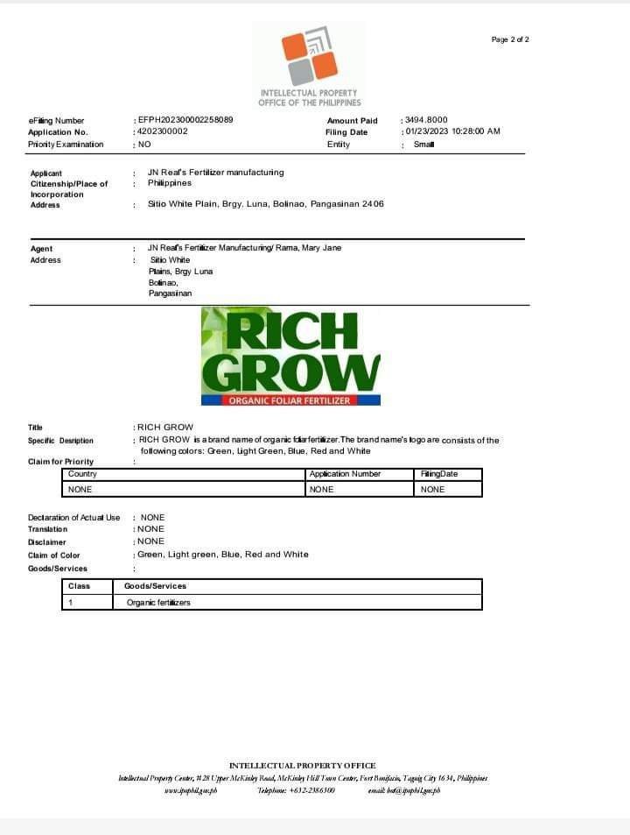
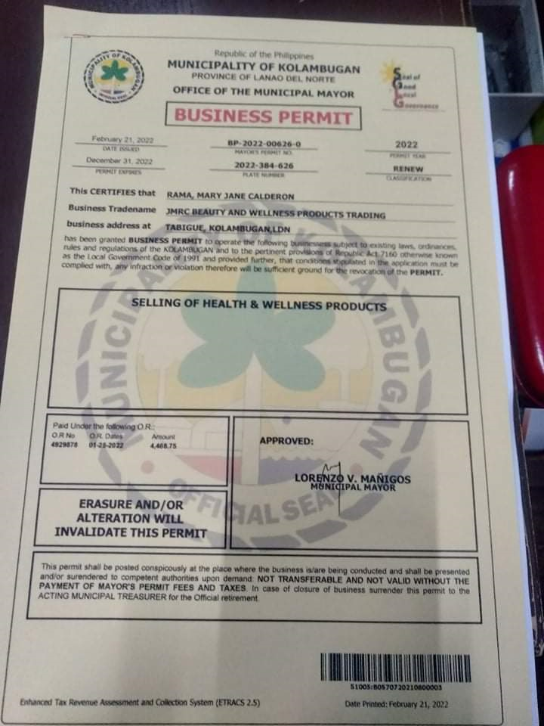
JMRC INTERNATIONAL

Slide 3

Business
Preview

Slide 4

WHAT JMRC INTL DO?
JMRC INTL Provide Solutions to Health Problems and Support Economic Growth Through Farming and a company that empowers the Ordinary People by giving Extra Opportunities to EARN…

Slide 5

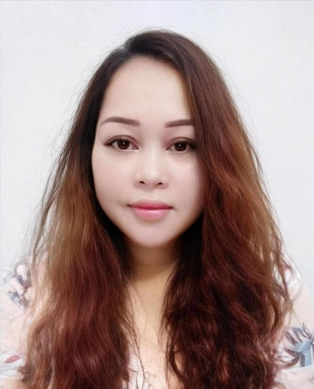
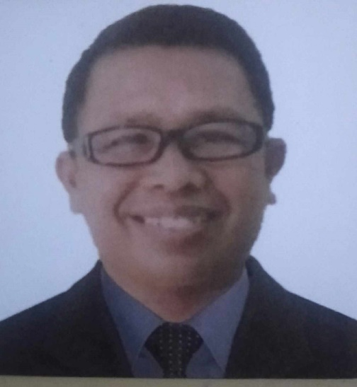
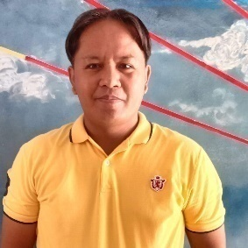
v
MARY JANE C. RAMA
CEO
GERALD MORILLO
VP-MARKETING
MANAGEMENT TEAM
FERDINAND D. ARCHE
VP-FOR OPERATION/I.T Director

Slide 6
OUR MISSION:
To provide high quality and affordable products that ensure the health of industry users and to seek the improvement of the community’s standard of living through offering on easy and less hectic way to earn income. TH

Slide 7

VISION
To become one of the best
Product Provider
in the Philippines

Slide 8
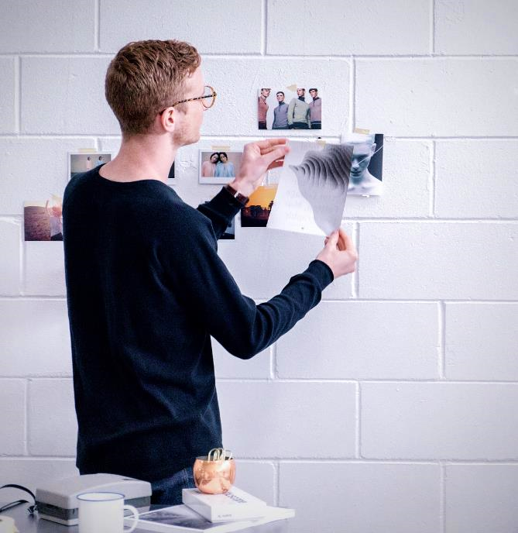
THE PRODUCTS
WHAT IS FARMING
HOW BIG IS FARMING BUSINESS
OUR
AGENDA
THE BUSINESS PLATFORM
MODERN BUSINESS SELLING APPROACH

Slide 9
OUR PRODUCTS

Slide 10
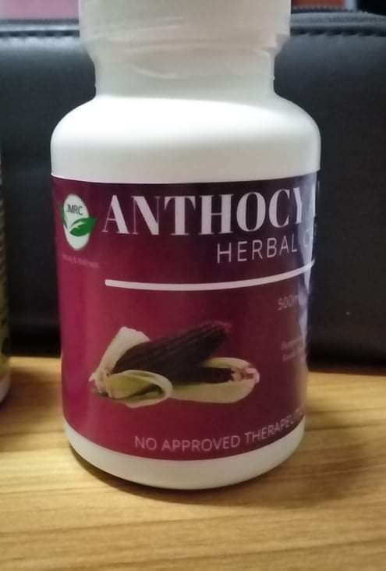
ANTHOCYANIN PURPLECORN
Great help for people suffering from:
PREVENT ANY TYPE OF CANCER
SUPER ANTI-OXIDANT
RECOVERING FROM OPERATION
ANTI-INFLAMMATORY
PARALYSIS
MANAGE AND PREVENT DIABETES
LOWER HYPERTENSION
LOWER BAD CHOLESTEROL
CHRONIC KIDNEY FAILURE
ALZHEIMER’S DISEASE
PARKINSONS’S DISEASE
IMPOTENCE
PREVENT HEART DISEASE
INGREDIENTS:
PERUVIAN PURPLE CORN
60 vegetable capsules at 500 mg

Slide 11


Slide 12


Slide 13
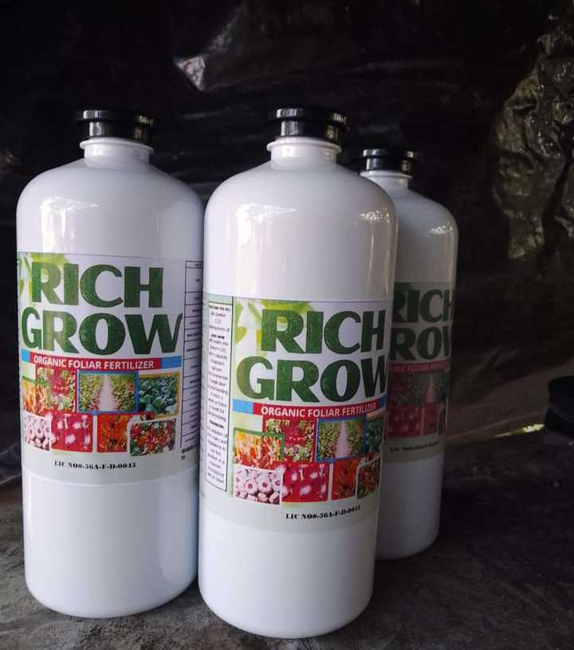
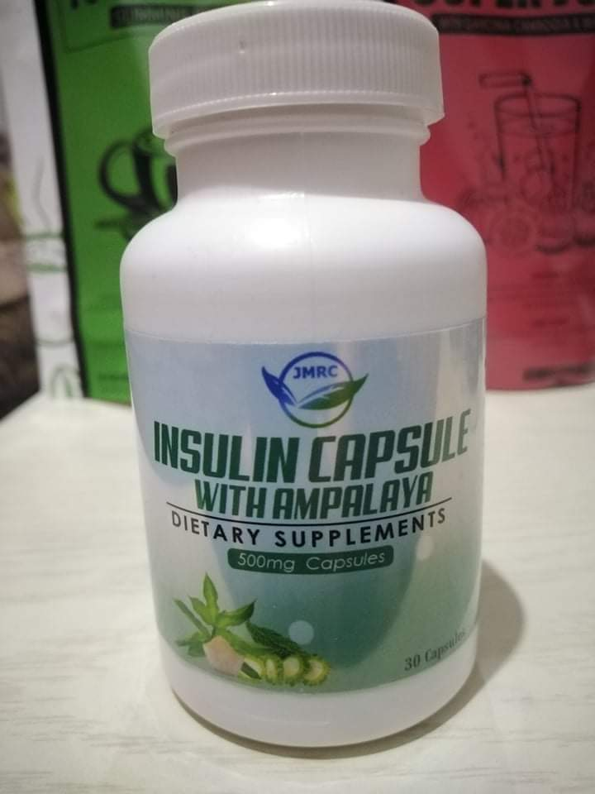
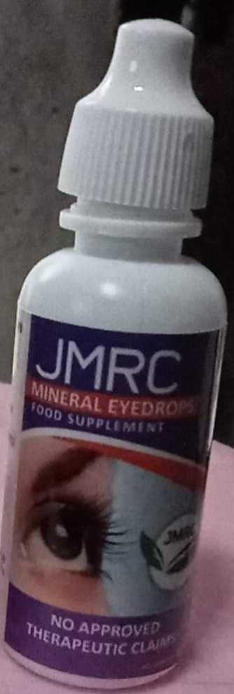
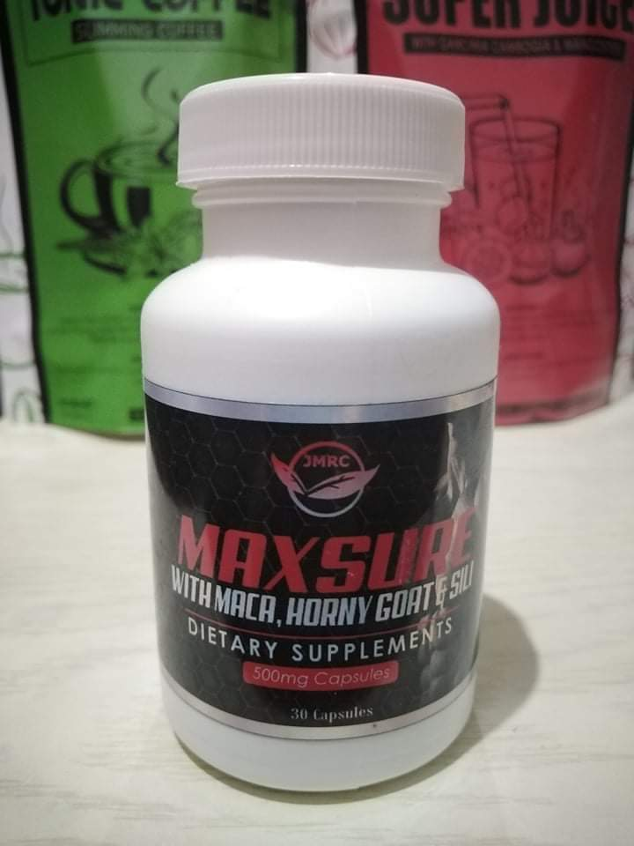
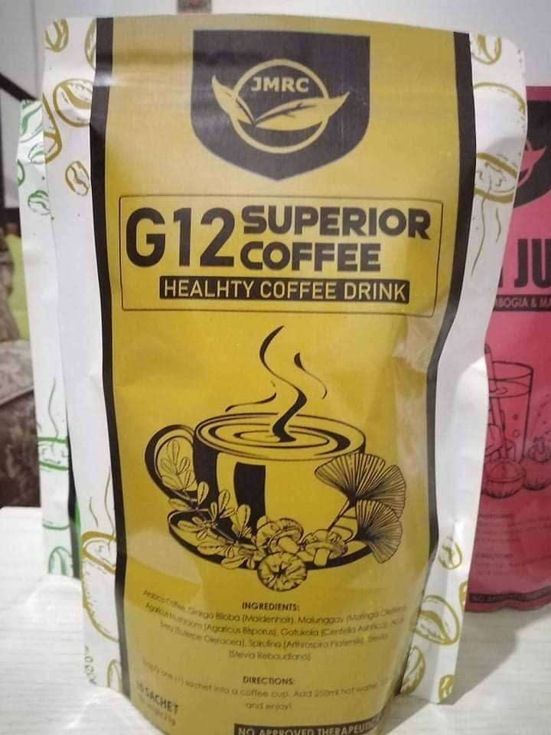
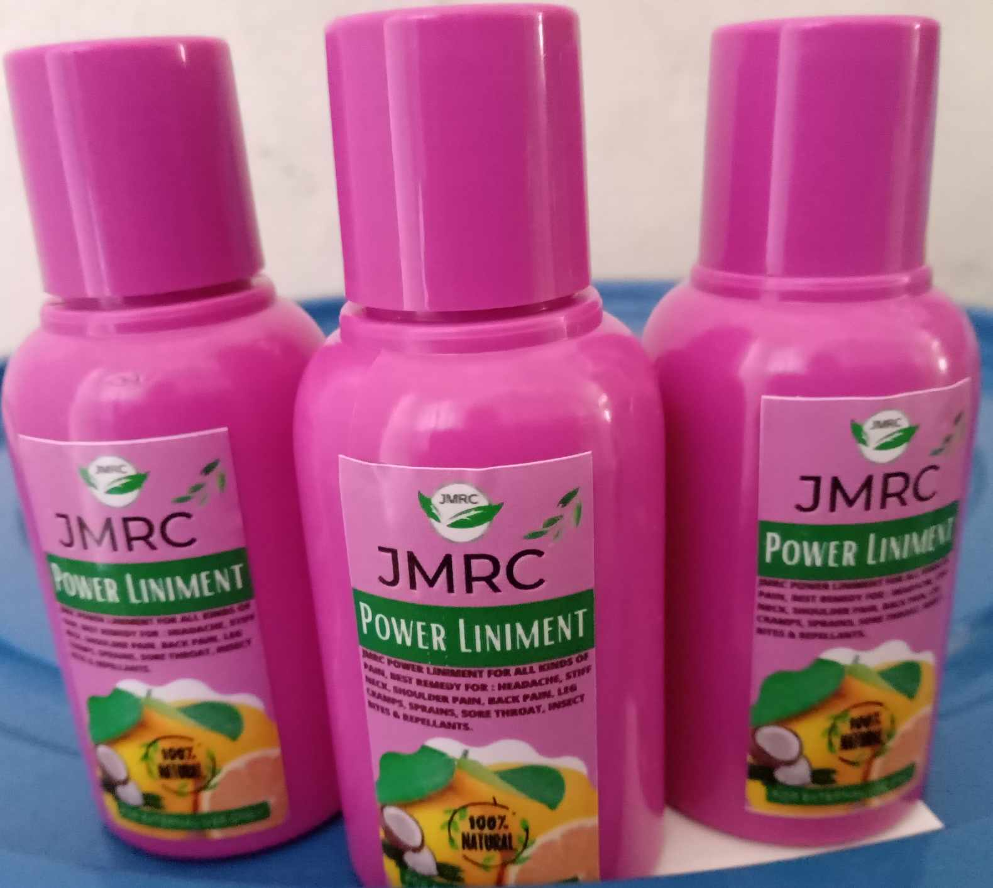
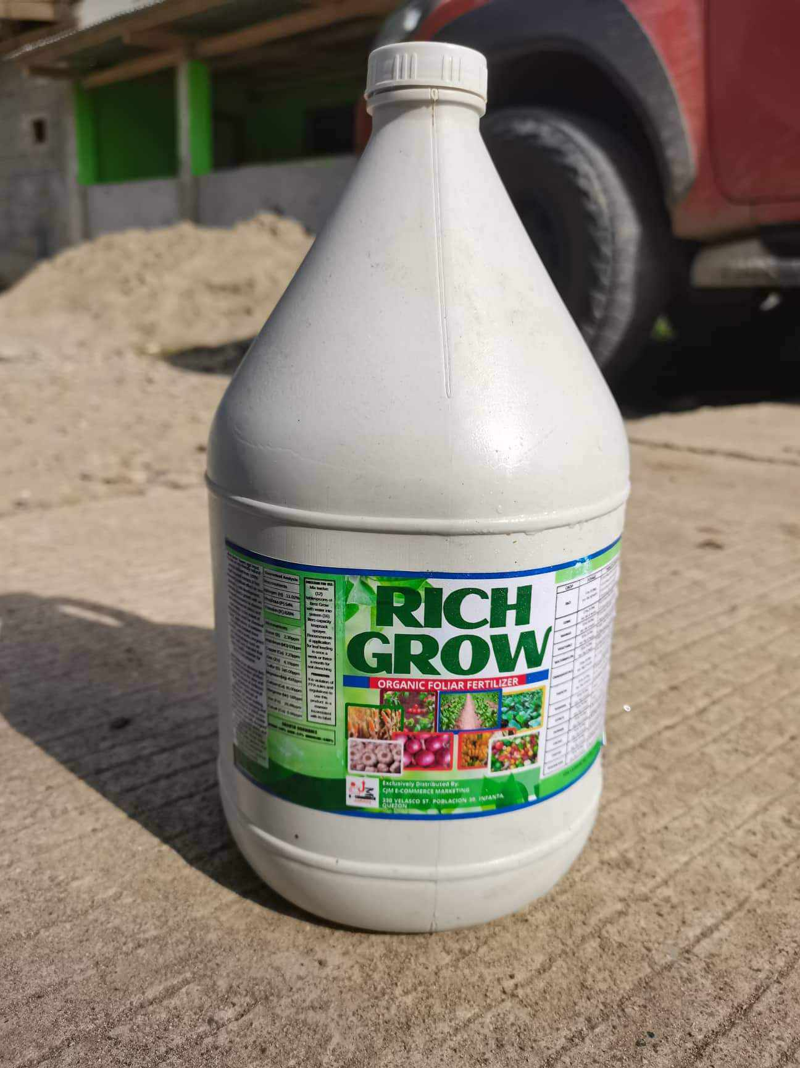
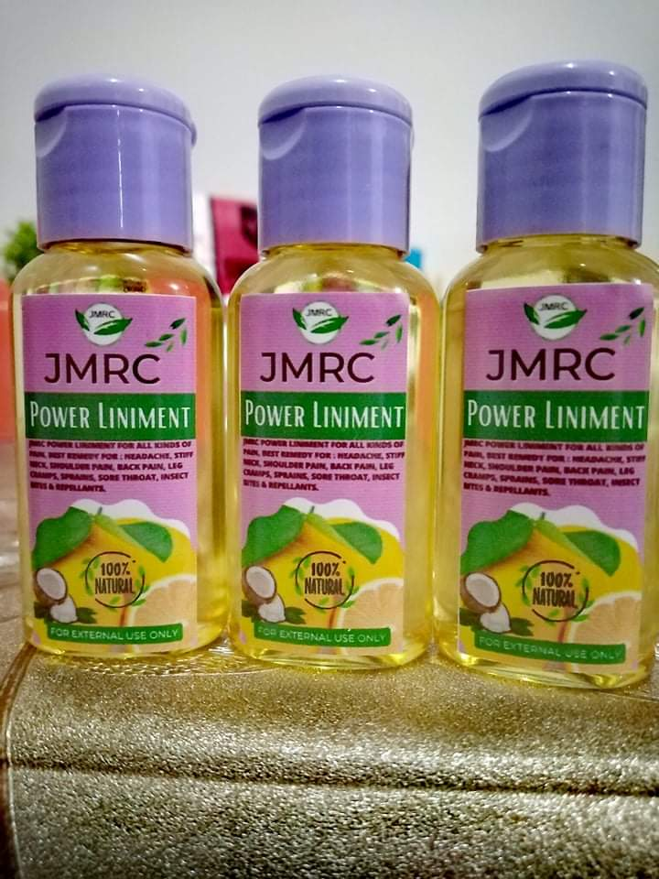
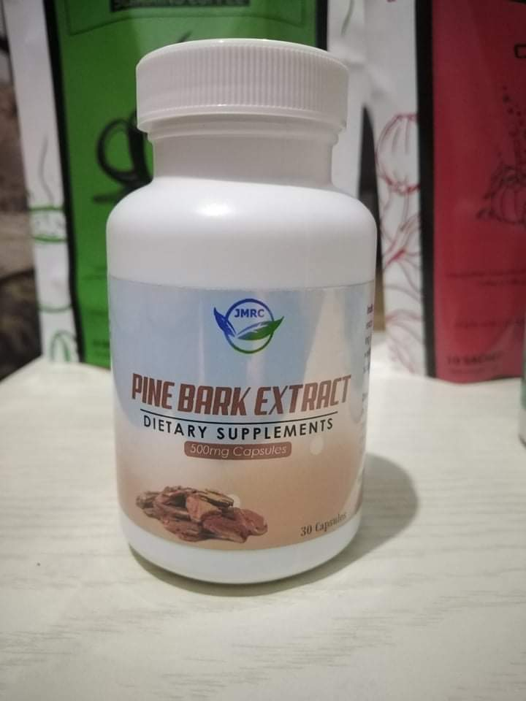

Slide 14
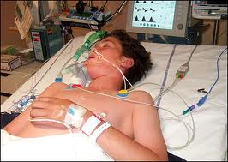

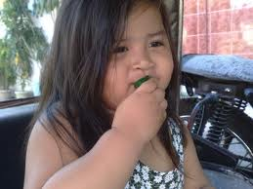
HEART DISEASE / STROKE
The Philippines has among the highest death rates for hypertension in Asia. (PHA)
In a workplace: Young people working in call centers
- Sits the whole day; no physical activity.
- A lot are also smokers and
- Eat cholesterol and fat-laden foods.
We are concerned that people in their 20s, 30s who are not even in their 50s have heart diseases. (PHA)

Slide 15
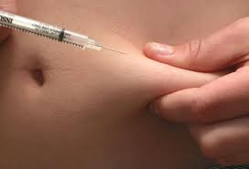
Experts say, 366 Million people WORLDWIDE now have diabetes
Roughly 3.5 million Filipinos have Diabetes.
This number doesn’t include the undiagnosed and pre- diabetics.
DIABETES
2 out of 3 Diabetics usually DIE either of Heart Disease or STROKE
These are indeed ALARMING statistics!!!

Slide 16
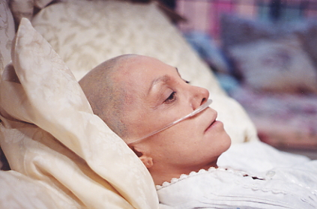
According to the World Health Organization (WHO), over 12 million people are diagnosed with cancer every year.
THAT’S 1 PERSON EVERY 3 SECONDS!
50,000 cancer cases have been recorded in the Philippines and the number is estimated to increase by 5% every year.
CANCER
Meanwhile, 16% of recorded cancer deaths are due to Breast Cancer
WARNING:
If no urgent action is taken, the number of cancer deaths may reach 14.5 million by the year 2024

Slide 17
WHAT IS FARMING?
Its the process of Preparing and doing things to Bring Good and Healthy Foods in Our Table.

Slide 18
HOW BIG IS FARMING INDUSTRY?
It’s a Trillion Dollar Industry

Slide 19
WHAT IS THE FLATFORM FOR JMRC INTL?
Our system is using the marketing method of (NETWORKING) combined with Direct Selling and Support System

Slide 20

SET UP YOUR OWN
ESTIMATED CAPITAL NEEDED
BUSINESS
USER
Hire a Programmer
To Make A Website
w/ CRM System
Php300,000
Buy a Domain
(.com or .ph or .biz)
*Renewable Annually
Php1,000
Avail of A Web
Hosting Facility
*Renewable Annually
Php 6,000
Buy your Initial
Inventory
Php 2,000,000
Php 2,308,000

Slide 21

IT’S TIME TO SET UP
YOUR PERSONAL
BUSINESS
USER
JUST BUY THE
PRODUCT PACKAGE
Php2,499.00
01
PRODUCT VALUE P2500+
02
MONITORING WEBSITE
03
INCOME OPPORTUNITIES
0

Slide 22
IT’S TIME TO SET UP
YOUR PERSONAL
BUSINESS
USER
JUST BUY THE
PRODUCT PACKAGE
Php10,999.00
01
PRODUCT VALUE P13000+
02
MONITORING WEBSITE
03
INCOME OPPORTUNITIES
0

Slide 23
IT’S TIME TO SET UP
YOUR PERSONAL
BUSINESS
USER
JUST BUY THE
PRODUCT PACKAGE
Php50,999.00
01
PRODUCT VALUE P65000+
02
MONITORING WEBSITE
03
INCOME OPPORTUNITIES
0

Slide 24

MODERN SELLING
APPROACH
ENDORSEMENT BONUS
Let’s
do
BUSINESS
DIRECT SELLING DISCOUNT
PAIRING BONUS
LEADERSHIP BONUS
Notes:
Photo credit: https://pixabay.com/photos/workplace-team-business-meeting-1245776/

Slide 25
1
ENDORSEMENT BONUS
PACKAGE | POINTS | REFERRAL | PAIRING | MAXIMUM DAILY INCOME OR PAIRING | LEADERSHIP BONUS | DISOUNTS
BRONZE P2,499 | 1 | P250.00 | P250.00 | 10 Pairs | P250.00 | 25%
SILVER P!0,999 | 4 | P1,000.00 | P1,500.00 | 25 Pairs | P3,000.00 | 25%
GOLD P50,999 | 16 | P5,000.00 | P4,000.00 | 50 Pairs | P15,000.00 | 25%

Slide 26

DIRECT SELLING BONUS
2
Earn 25-50% Rebates every time you purchase any products of JMRC PRODUCTS.

Slide 27


PAIRING BONUS
3
No. of Sponsor
Total Income per level
P250
P250
P250
P1000
P5000
P1,000
P250
P250
P1,000
P1000

Slide 28
LEADERSHIP BONUS
Req: 2 direct Referral
4
DIRECT REFERRAL + LEADERSHIP
P3,000
P15,000
LEADERSHIP BONUS
BRONZE P250
SILVER P3,000
GOLD P15,000

Slide 29

HEALTH AND FARMING OPPORTUNITIES
v
THANK YOU
and
GOD BLESS
FERDINAND D. ARCHE
VP Operation /I.T Provider
Sun: 0932-7360310

